Slide 1

Constructing accurate predictions of impressions for an advertisement from the Snapchat Political and Advocacy ads library
Durdona Gaibova

Slide 2
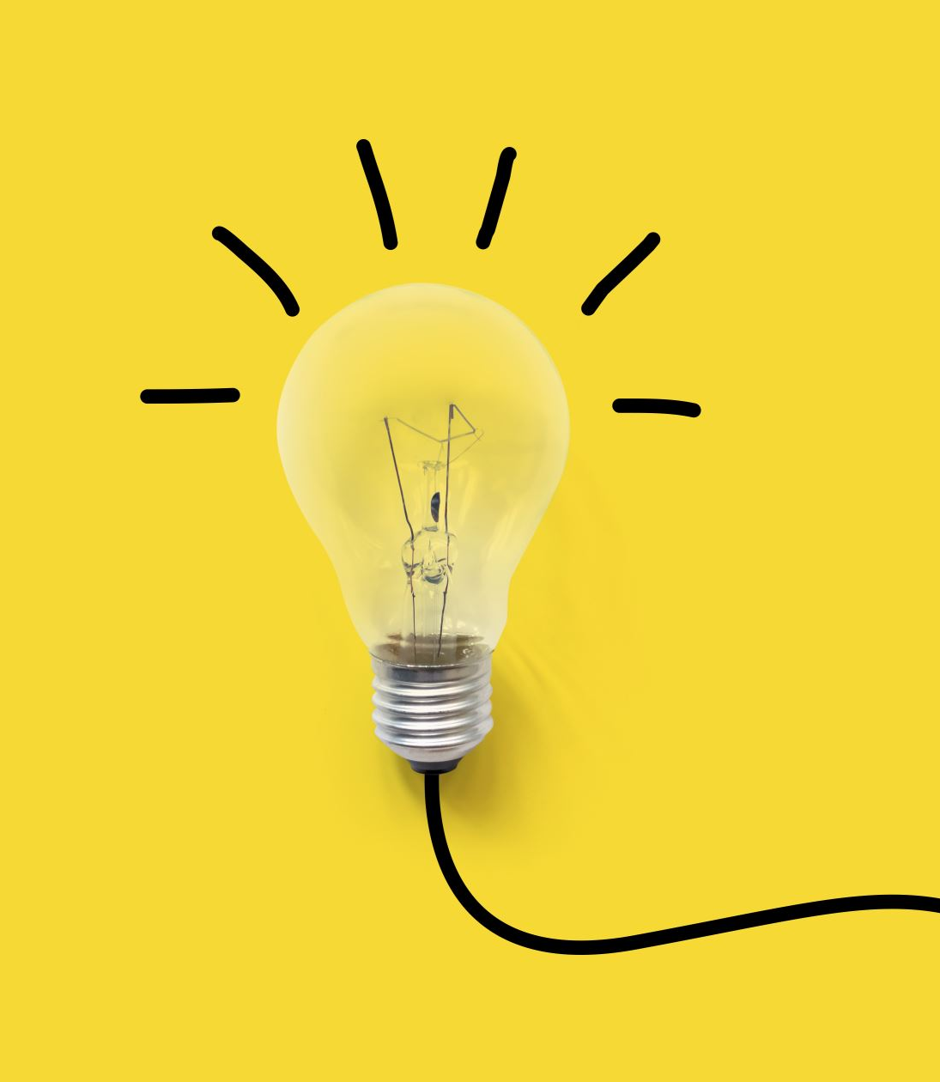
Question/ Hypothesis
What is the best way to predict impressions based on the data given?

Slide 3
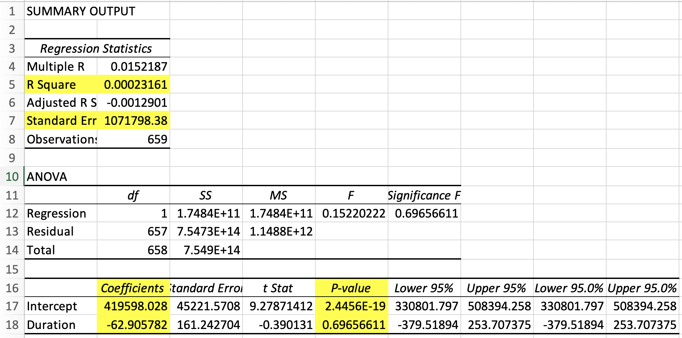
Regression 1- Duration as Independent Variable

Slide 4
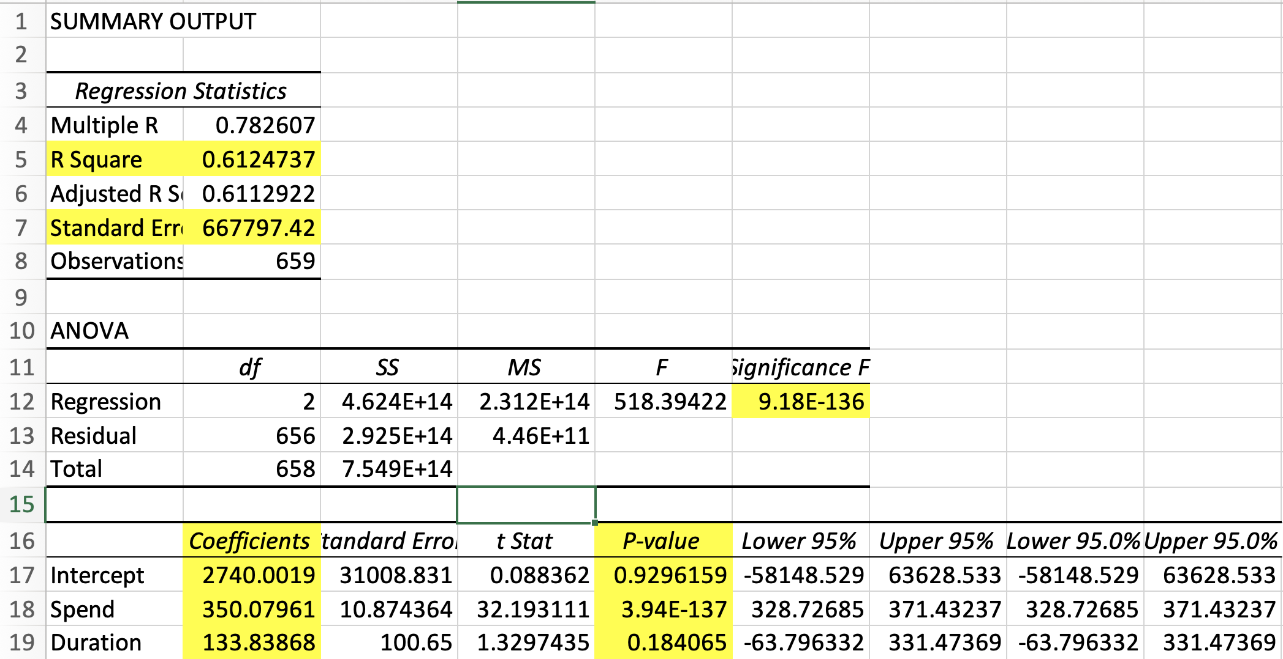
Regression 2- Duration and Money Spent as Independent Variables

Slide 5
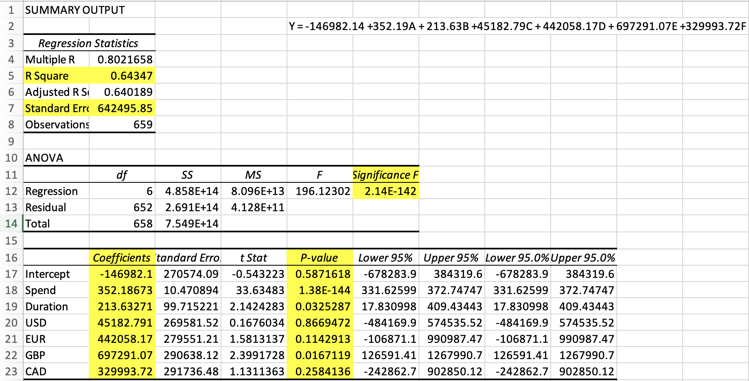
Regression 3- Duration, Money Spent, and Currencies as Independent Variables

